Slide 1
Welcome to Balhousie Primary School Online Payment Service
www.parentpay.com

Slide 2
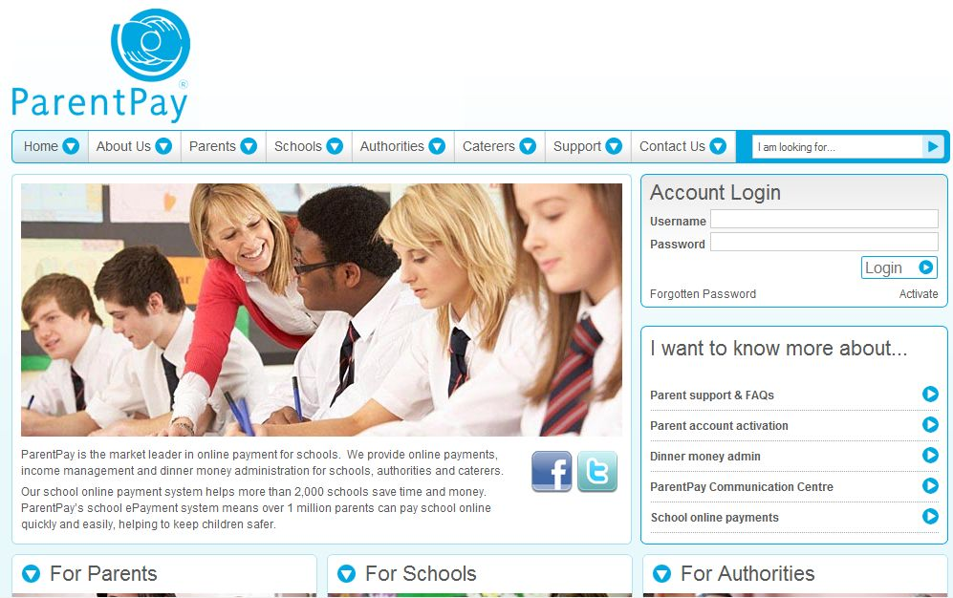
www.parentpay.com

Slide 3
ParentPay
ParentPay is our secure online income collection and management service which allows you to make payments to school using your debit/credit cards or in cash using the ParentPay top-up card at local PayPoint outlets. You can make payments for:
school meals
trips
before/after school clubs
... in fact, anything at all!
www.parentpay.com

Slide 4
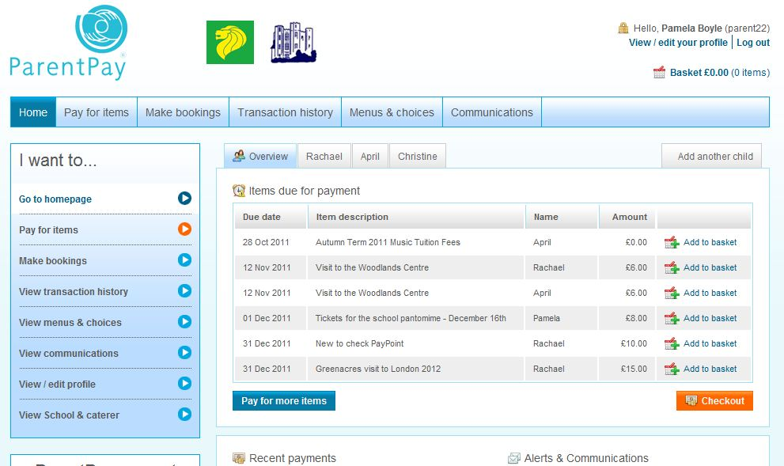
How does it work?
We post items for payment to your account and you add them to your basket.
www.parentpay.com

Slide 5
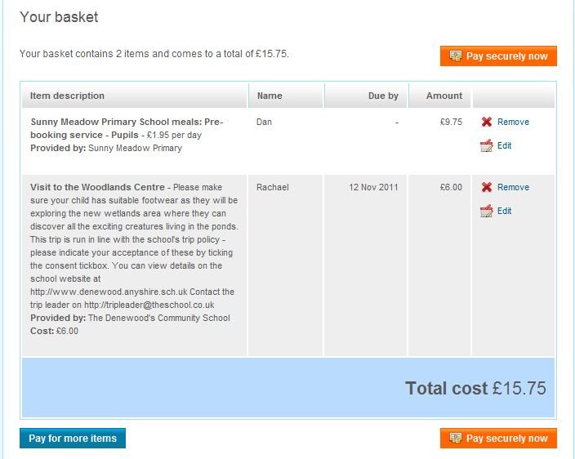
How does it work?
You will make your payment online via ParentPay or using PayPoint.
www.parentpay.com

Slide 6
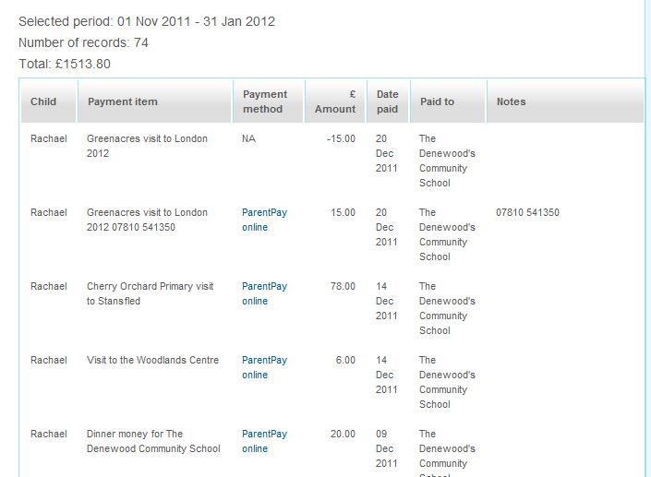
How does it work?
The ParentPay system will keep a record of all of your transactions.
www.parentpay.com

Slide 7
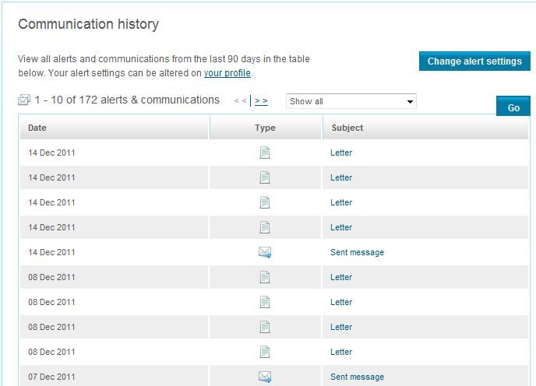
How does it work?
You are able to set your account to receive automated alerts.
In addition the school are able to send communication to you via Email, SMS or Letter.
www.parentpay.com

Slide 8
Support your School
Our vision is to create a fully cashless school; creating a safer, more secure environment whilst enabling us to further support teaching and learning.
ParentPay greatly reduces administration tasks in the classroom and school office, increasing security:
no cash/cheques to count and bank
no cash held on the premises
payments for us go straight into our school bank account
payments for our suppliers go straight into their bank accounts
enhance school-home communication
www.parentpay.com

Slide 9
Making life easier for Parents and Carers
Paying via ParentPay helps our school enormously, whilst providing you with a more secure way to make payments.
ParentPay also gives you:
convenient anytime, anywhere payments 24/7
flexible, secure payment options
peace of mind knowing funds have reached school
automated balance and payment alerts via email/SMS
1000’s of parents are using ParentPay everyday, make sure you are one of them.
Thank you for your support!
www.parentpay.com

